Slide 1



Slide 2

Welcome to the WABC
Quarterly Community Meeting

Slide 3
Steering Committee Members
Lorena Shah – Opportunity Council
Yarrow Greer – Opportunity Council
Emily Hermansen – Opportunity Council
Patty Boyce – United Way of Whatcom County
Katherine Freimund – Whatcom Literacy Council
Caitlin Willson – WECU
Ashley DeLatour – FuturesNW
Megan Wingo – FuturesNW
Michael Cox – Whatcom County Library System
Edith Tate – Opportunity Council
Notes:
Assets are the stock of wealth in a household.
They help individuals and families:
Work through financial crisis
Maintain personal and family stability
Invest in their children and communities
Plan for retirement
Pass resources to future generations

Slide 4
Land Acknowledgement
I would like to begin by acknowledging that we gather today on the ancestral homelands of the Coast Salish Peoples, who have lived in the Salish Sea basin, throughout the San Juan Islands and the North Cascades watershed, from time immemorial. Please join me in expressing our deepest respect and gratitude for our indigenous neighbors, the Lummi Nation and Nooksack Tribe, for their enduring care and protection of our shared lands and waterways.
Notes:
Assets are the stock of wealth in a household.
They help individuals and families:
Work through financial crisis
Maintain personal and family stability
Invest in their children and communities
Plan for retirement
Pass resources to future generations

Slide 5
Mission Statement
The Whatcom Asset Building Coalition (WABC) is a community collaboration supporting financial self-sufficiency through education and advocacy.
Our mission is to foster collaboration in the community to increase the financial stability of people in Whatcom County.
Notes:
Assets are the stock of wealth in a household.
They help individuals and families:
Work through financial crisis
Maintain personal and family stability
Invest in their children and communities
Plan for retirement
Pass resources to future generations

Slide 6
Agenda
The Other Pandemic:
Inequities in local COVID economic impacts and recovery
Welcome, housekeeping, and introductions
FAFSA/WASFA: updates and resources – Ashley DeLatour, FuturesNW
WABC KEYNOTE: Anneliese Vance-Sherman, ESD Regional Labor Economist
Prosperity Project Community Needs Assessment – Greg Winter, Opportunity Council
Notes:
Assets are the stock of wealth in a household.
They help individuals and families:
Work through financial crisis
Maintain personal and family stability
Invest in their children and communities
Plan for retirement
Pass resources to future generations

Slide 7
Financial Aid 101

Slide 8


Introduction to Financial Aid

Slide 9


About WSAC and FuturesNW
WSAC: We advance educational opportunities and attainment in Washington.
FuturesNW: We are a non-profit on a mission to level the socio-economic playing field by supporting students from under-served communities to achieve their career and college dreams.
Notes:
https://wsac.wa.gov/
Our mission
We advance educational opportunities and attainment in Washington. In pursuit of our mission, the Washington Student Achievement Council:
Leads statewide strategic planning to improve educational coordination and transitions.
Supports Washingtonians through the administration of financial aid, 529 college savings plans, and support services.
Advocates for the economic, social, and civic benefits of postsecondary education.
Our vision
We inspire and foster excellence in educational attainment.
Our commitment to equity
In support of advancing educational attainment for all Washingtonians, we commit to fostering a culture of equity, diversity, and inclusion among our staff and in all areas of our work.

Slide 10
What Will I Learn Today?
What is Financial Aid
Types of Financial Aid
When You Should Apply for Financial Aid
How to Apply for Financial Aid
Scholarships
Help and Resources

Slide 11
What is Financial Aid?
Financial aid is money to help pay for college or career school. Grants, work-study, loans, and scholarships help make college affordable.

Slide 12

Financial Aid Is An Umbrella
Grants
  Income-based, federal, state and institutional.
Scholarships
  Merit and income-based, from public, private, and nonprofit sources.
Loans
  Income-based, federal and private.
Work-Study
  Income-based, federal, state and institutional.
Notes:
There is not just one meaning for “financial aid”. These are the fours types: • Grants: income-based, federal and state. • Scholarships: merit and income-based, from public, private, and nonprofit sources. • Loans: income-based, federal and private. • Work Study: income-based, federal and state. We will talk next about the specifics.

Slide 13
Grants
A grant is gift aid that often based on financial need and does not need to be repaid (unless, for example, you withdraw from school and owe a refund).
Washington College Grant
Pell Grant
Notes:
For more information about the Washington College Grant and other state financial aid please go to https://wsac.wa.gov/wcg
For more information about Federal Pell Grants https://studentaid.gov/understand-aid/types/grants/pell

Slide 14

Washington College Grant (WCG)
Washington State has made a groundbreaking commitment to
financial aid for low- and middle-income people of all ages with the new Washington College Grant (WCG).
Notes:
The Washington College Grant (WCG) program—formerly known as the State Need Grant (SNG)—makes education and training beyond high school affordable. WCG provides need-based financial aid to income-eligible students pursuing education after high school. The maximum award amount will cover full tuition at any approved/eligible in-state public college or university, including community or technical colleges, or provide a comparable amount toward tuition and other education-related costs at an approved private college or career training program. For more information go to https://wsac.wa.gov/wcg

Slide 15
Washington College Grant
An eligible student from a family of four making around $56,000 or less per year would receive a full award.
Partial grants are available for families making up to the state’s median family income, around $102,000 per year.
Notes:
Learn more about WCG eligibility and awards at https://wsac.wa.gov/wcg-awards

Slide 16


Scholarships
Scholarships are gifts that don’t have to be repaid and are designed to help students pay for college. They can be a one-time gift or renewable.
You can start your scholarship search by going to thewashboard.org or Futuresnw.org
Notes:
https://washboard.wsac.wa.gov/login.aspx
Looking for scholarships? theWashBoard.org makes it simple.
The Washboard connects Washington students of all types with Washington scholarship providers….for FREE.
Whether you’ll be attending in state or out, you save time by entering your profile once and letting us find the scholarship opportunities that fit. theWashBoard.org is spam-free and will never sell your information
How does it work? Scholarship providers build a listing for each scholarship they want to offer on our site. This listing provides all the necessary information for potential applicants. Students-scholarship seekers-create a profile online, which is then compared to all available scholarships. A list of the seeker’s best scholarship matches is immediately displayed to them online. The seeker creates an application for their matches after reading the details provided. Seekers can apply for as many scholarships as they choose. The scholarship seeker submits an application to the provider either by mail, by website, or by using theWashBoard.org as the electronic application host. The provider reviews their applications. If theWashBoard.org serves as the electronic host, the provider can review applications online or download and print. The site can also be used to email applicants about their scholarship status

Slide 17
Work-Study
Tutoring
Work-Study provides part-time jobs for students with financial need, allowing them to earn money to help pay education expenses. These jobs are typically on campus.
Outreach
Fitness Center
Work-Study
Student Life
Library
Computer Lab

Slide 18
Loans
A student loan is money you borrow for your education, and pay back over time. Unlike grants or work-study you do have to pay back your loans. You do not have to accept all the loans offered to you.
Unsubsidized Student Loans
  Interest begins accruing as soon as the loan is disbursed, including while you are enrolled in school.
Subsidized Student Loans
  Interest is paid by while you're enrolled at least half time in college.
Notes:
For more information about federal student loans, go to https://studentaid.gov/understand-aid/types/loans
You can find resources on student loans at our student loan advocacy site at https://wsac.wa.gov/loan-advocacy and https://www.studentloaned.wa.gov/

Slide 19
Sources of Financial Aid
Federal
State
College
Organizations
Typically can be used at most schools in most states.
Typically for residents to attend most colleges in the state.
Offered by a specific school to attend that school.
Offered by non-profits, business, churches, etc.
Notes:
Financial aid can come from several sources: Federal: This is from the US Department of Education and can be used at most colleges in the US. They have to be able to receive financial aid. Students can take to another state. State: For example, Washington state financial aid is for residents to attend colleges in WA. They do not necessarily have to be public colleges, but they have to be able to receive state financial aid. There are currently over 60. College: Every college will have their own scholarships, etc that they offer to students who are going to their school. Organizations: These tend to be scholarships (organizations) or private loans (banks). We will talk about applications for these specific forms of aid later.

Slide 20

Examples of Federal Financial Aid Programs
Pell Grant
Federal Work-Study
Unsubsidized/Subsidized student loans
Parent loans
Notes:
There are several types of federal financial aid. Students need to be U.S. citizens or eligible non-citizens (i.e. permanent residents with a Green Card as an example) to apply. Pell Grant: The largest income-based grant. You may be familiar with this grant as it is a long-standing program. There have been some changes over the years, so make sure you investigate current Pell Grant requirements such as maximum award amounts use during the summer. Work-study: Students can work on campus and their salary is paid from the Dept of Education on-campus employer—>student. Not all on campus jobs require a student to be part of the work-study program. Loans: Both these are in the student’s name. The difference is that with Unsubsidized student loans the student will ultimately pay the interest accrued once they graduate and/or leave college. Subsidized student loans – the government pays, or subsidizes the interest. Parent loans: Would be taken out by the parent to pay for the student’s expenses. There are additional requirements, such as a credit check. There is not limit on the loan amount for parent loans. If offered any/all of these loans from the government, students/families can accept none, partial, or all that they want to utilize. There are also private loans from banks but they typically have higher interest rates and more limited repayment options that federal loans. Students apply for these programs using the Free Application for Federal Student Aid (FAFSA). Students who are not eligible to apply for these programs due to immigration status would not be eligible for these programs, such as federal student loans.

Slide 21


Examples of State Financial Aid
Washington College Grant (formerly the State Need Grant)
College Bound Scholarship
State Work-Study
Passport to Careers
Opportunity Grant
Notes:
Learn more about Washington’s state financial aid programs, collectively known as opportunity pathways go to https://wsac.wa.gov/sfa-overview
These are examples of state financial aid programs that WA residents who are eligible can use in WA at eligible colleges – you may see them referred to as Washington Opportunity Pathways. Washington College Grant (formerly the State Need Grant) largest, income based grant. The amount depends on what type of school (out of the over 60) you attend. College Bound Scholarship: This is an early commitment of state financial aid to cover certain college costs. Students must have signed up in middle school. We’ll talk more later. State Work-Study: Similar to the federal program but the funding comes from Washington State versus the federal government. Passport to Careers: program that provides additional resources for both former foster youth and unaccompanied homeless youth (https://www.wsac.wa.gov/sites/default/files/Passport.Student.FAQs.pdf) Opportunity Grant: to attend a 2 year community or technical college 5 Students who can complete the FAFSA (U.S. citizens and permanent residents) are also applying for state aid programs when the complete the FAFSA. Undocumented students who meet program and state residency requirements can apply using the Washington Application for State Financial Aid (WASFA).

Slide 22
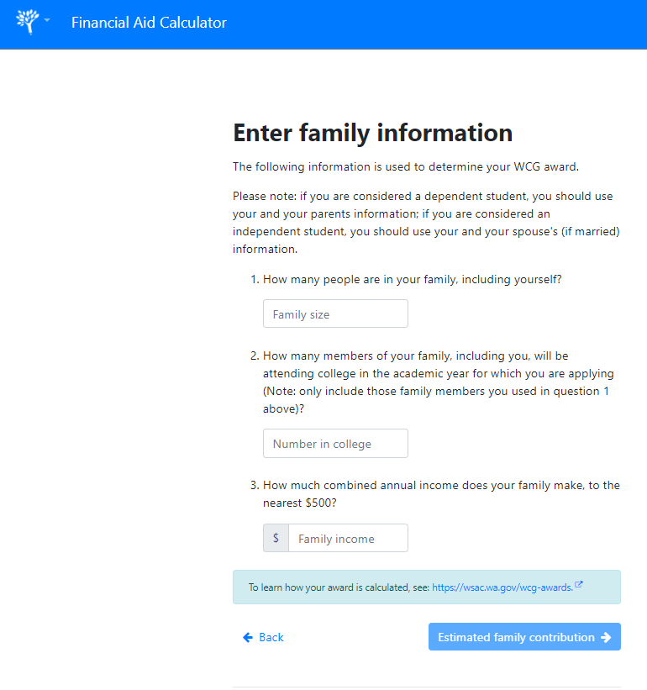
State Financial Aid Calculator
This tool calculates potential awards from the Washington College Grant and Pell Grant programs.
There may be more aid available to you from other state and federal programs, private scholarships, or directly from the college you attend.
The only way to know for sure how much financial aid you can receive is to complete a FAFSA or WASFA financial aid application
portal.wsac.wa.gov/a/aid-calculator
Notes:
https://portal.wsac.wa.gov/a/aid-calculator/ New Resource - This tool calculates potential awards from the Washington College Grant and Pell Grant programs.

Slide 23
FAFSA/WASFA: Rule of One
FAFSA
WASFA
OR
  Free Application for Federal Student Aid
  FAFSA.gov
  Washington Application for State Financial Aid
  wsac.wa.gov/WASFA
Both Applications Open October 1st
Notes:
Speaking of FAFSA and WASFA… Students should only complete one application. Fill out the FAFSA if you are eligible for federal aid (i.e. US citizen/permanent resident) and this will also be used to determine state aid eligibility If you are ineligible for federal aid due to immigration status but you are eligible for a state financial aid program (i.e. for undocumented students) complete the WASFA. Some colleges may also use WASFA in replace of a FAFSA when calculating institutional aid There are resources to help you complete these applications and determine which one to file at https://wsac.wa.gov/WASFA
Note to presenter: You should not ask students which application they should file or their status. Let them self-identify.

Slide 24
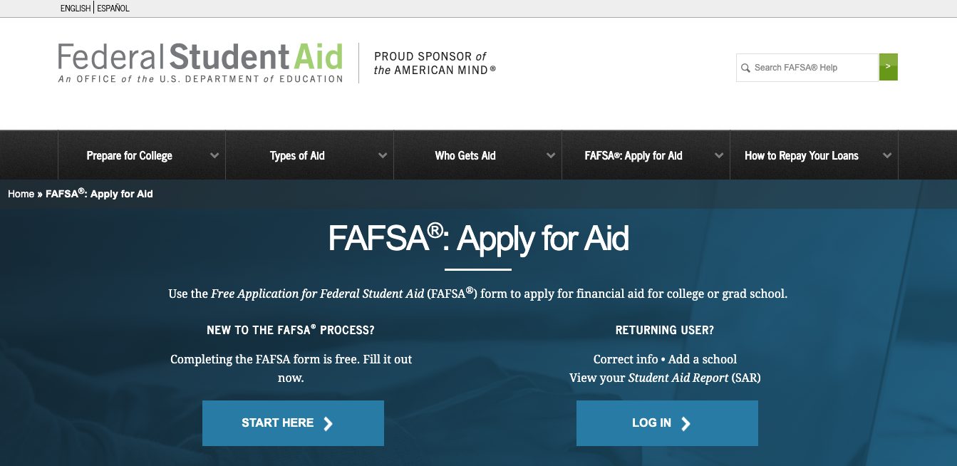
Free Application for Federal Student Aid (FAFSA)
Notes:
Here you can see the Free Application for Federal Student Aid (FAFSA) home page https://studentaid.gov/h/apply-for-aid/fafsa

Slide 25
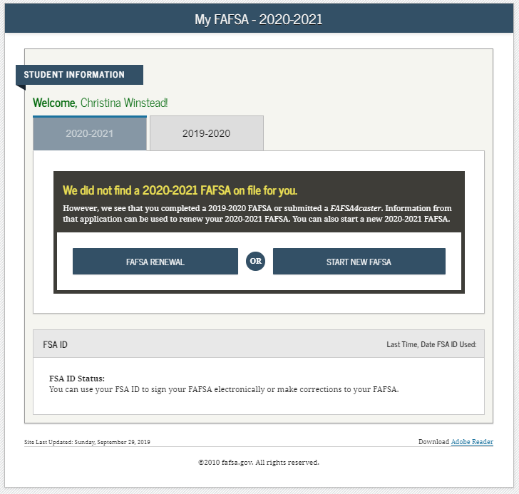
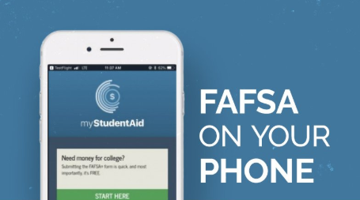
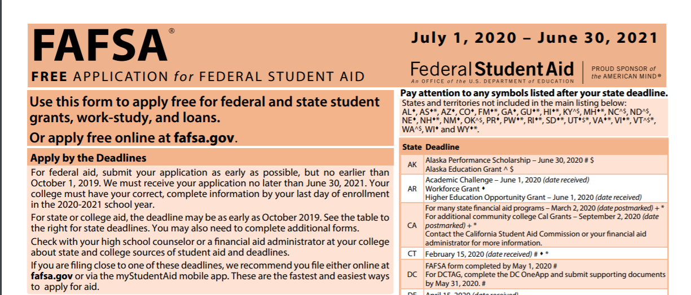
Three Ways to Apply for the FAFSA
Website
FAFSA App
Paper FAFSA
Notes:
Students can use any of these ways to apply for the FAFSA. The website and the FAFSA app are the two quickest ways to apply but students can use the paper application if they are unable to access the online or phone app.

Slide 26
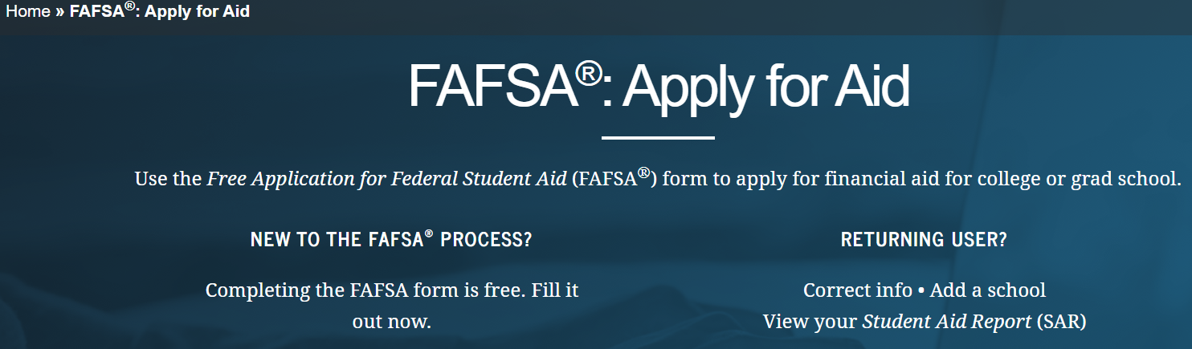
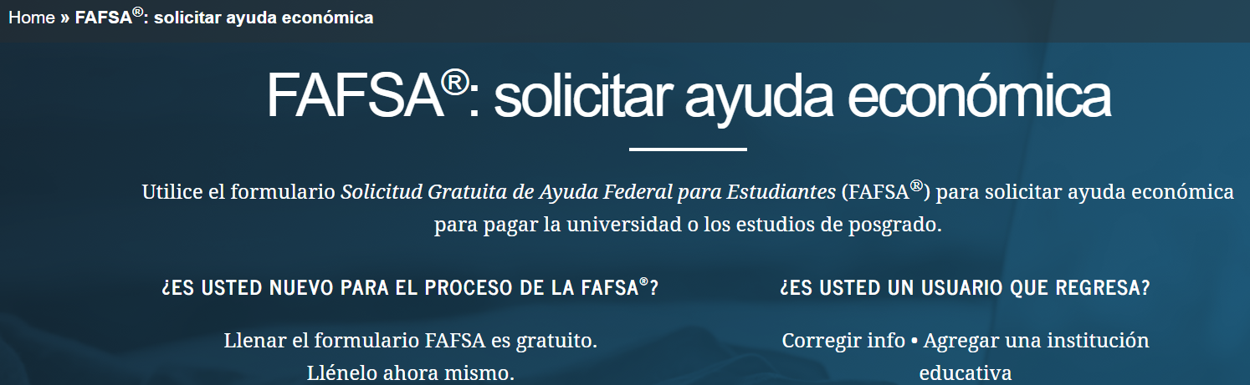
FAFSA Website Language Options
English
Spanish
Notes:
The FAFSA site is offered in English and Spanish.

Slide 27
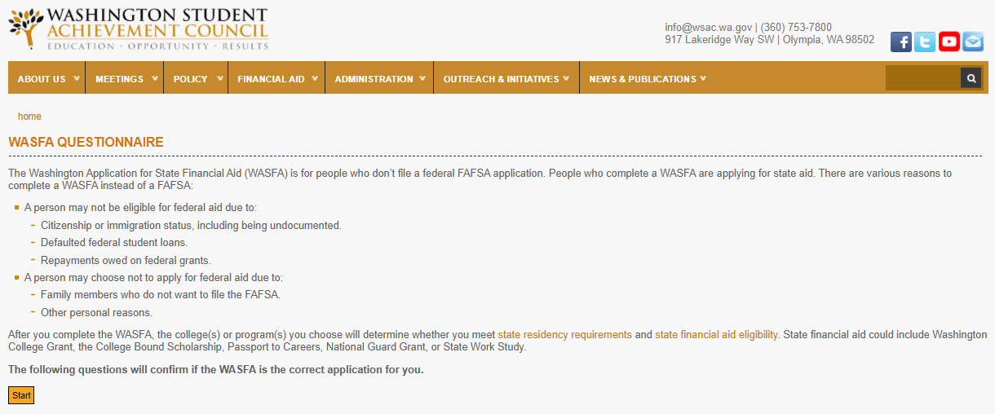
Washington Application for State Financial Aid (WASFA)
https://wsac.wa.gov/WASFA
Notes:
Here is the Washington Application for State Financial Aid (WASFA) application site https://readysetgrad.wa.gov/wasfa

Slide 28
Financial Aid Timeline
Gather required documents
Review your award letters and accept your aid.
Create an FSA ID or WASFA account (only created once)
Follow up with colleges for any additional request for information
FAFSA & WASFA open October 1st
Students apply for financial aid and admissions

Slide 29
Important Financial Aid Information for the Class of 2022 or adults wishing to start college or apprenticeship program in 2023
Opens October 1 every year
Apply early to maximize aid opportunities
The Class of 2022 will complete the 2022-23 FAFSA or WASFA
You will use your 2020 income information

Slide 30
Class of 2022 Next Steps
Explore Your Options
  Explore your post secondary options using your high school and beyond plan.
  Talk to your counselor to make sure you are on track for graduation.
Determine Which Financial Aid Application To Use
  If you are not sure which application to complete go to https://wsac.wa.gov/WASFAelig
Create an FSA ID or WASFA Account
  You can create an FSA ID by going to https://fsaid.ed.gov/npas/index.htm
  You can create a WASFA account by going to https://wsac.wa.gov/WASFAelig
  Complete your application starting October 2021

Slide 31

Resource: College Knowledge
Developed in collaboration with OSPI, PSCCN, Road Map Project, WSAC, and WCAN
Digital Resource: https://www.wcan.org/college-knowledge/
Physical copies in Spanish and English can be order from 12th Year Campaign
Notes:
https://www.wcan.org/college-knowledge/
The College Knowledge Project
Over the past several years, a team of organizations worked together to create the College Knowledge Project, consisting of 23 student-tested and approved digital handouts compiled into a workbook designed to support college and career education planning. Full workbooks can be ordered through the 12th Year Campaign and digital copies can be found via the Washington College Access Network website. Lesson plans are also available for each chapter of the workbook to be used to guide students through the College Knowledge content.

Slide 32
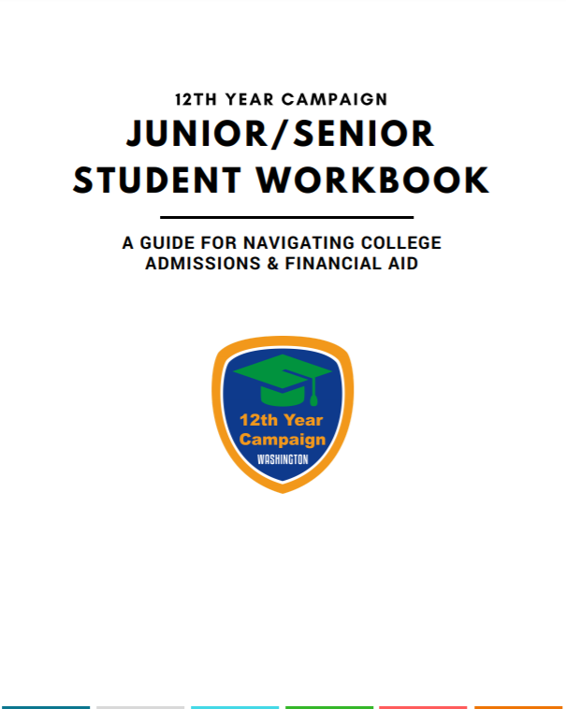
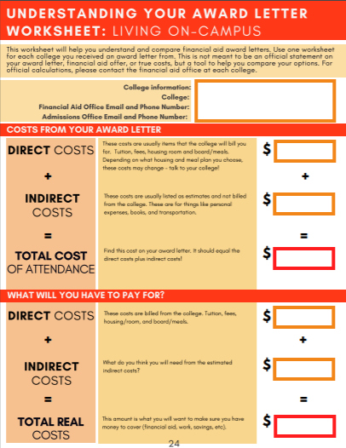
Resource: Junior/Senior Student Workbook
https://wsac.wa.gov/12th-year-campaign
Notes:
This comprehensive workbook will assist your juniors and seniors with identifying their postsecondary plan goals with useful activities as well as provides critical information around admission and financial aid programs.
The 12th Year Campaign workbook can be found at https://wsac.wa.gov/sites/default/files/2020.12thYear.JrSrWorkbook.pdf

Slide 33


Local Resource: FuturesNW Resources Platform
RESOURCES — Futures Northwest (futuresnw.org)

Slide 34



We Are Here to Help!
Online:
  wsac.wa.gov
  www.thewashboard.org
  wastate529.wa.gov
On Twitter:
  @WSACouncil
On Facebook:
  www.facebook.com/WSACouncil

Slide 35

We Are Here to Help: Financial Aid events
For more local and statewide events, check out: https://www.futuresnw.org/events
or
the 12th Year Campaign Events Page
For questions about Financial Aid contact
FuturesNW Programs Manager
Ashley DeLatour
adelatour@futuresnw.org

Slide 36

Questions

Slide 37
Keynote: The Other Pandemic: Inequities in COVID-19 economic impact and recovery by Anneliese Vance-Sherman, ESD Economist

Slide 38
The “Other” Pandemic:
Inequalities in local COVID-19 economic impacts & recovery
Whatcom Asset Building Coalition
Quarterly Community Meeting
September 21, 2021
Anneliese Vance-Sherman, Ph.D.
Regional Labor Economist
Washington Employment Security Department
anneliese.vance-sherman@esd.wa.gov

Slide 39
Setting the stage:
Labor force characteristics prior to the pandemic

Slide 40
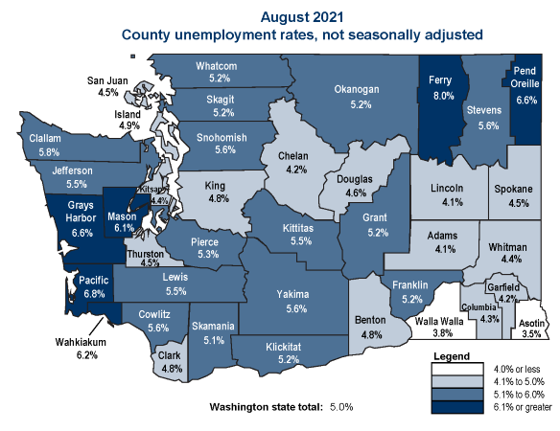
How well are workers connecting with their labor markets?

Slide 41
Labor force participation

Slide 42
Unemployment rates

Slide 43
What makes the COVID-19 pandemic recession different?
Notes:
Labor supply versus labor demand
In a normal recession the shock is felt by employers (demand side shock)
Lack of demand for products or services → reduced demand for labor
This time, we had demand side shock
Reduced demand for products and services, differing by industry but also a result of global supply chain disruptions
Also demand side shock as a result of pandemic and pandemic-driven policy (artificial shock)
But we also had significant (and lasting) supply side shock
Workers were not available to work
Illness
Role of UI changing
Childcare and school
Record numbers of job openings signal that the demand side has recovered more quickly than the supply side

Slide 44
Every recession is unique, however…
The labor market impacts were deeper and more swift than usual, disproportionately impacting industries that largely female workforces.
Demand for and supply of labor were both impacted
This recession impacted women to a greater extent than men both quantitatively and qualitatively
This recession exacerbated existing inequalities and barriers to access for BIPOC
Notes:
I will address each of these points in my brief presentation, and our panel will be able to elaborate on some of the ways that these impacts have impacted women and businesses in the community, and explore possible solutions moving forward.
First, let’s define “she-cession” that is, after all why we are here.

Slide 45
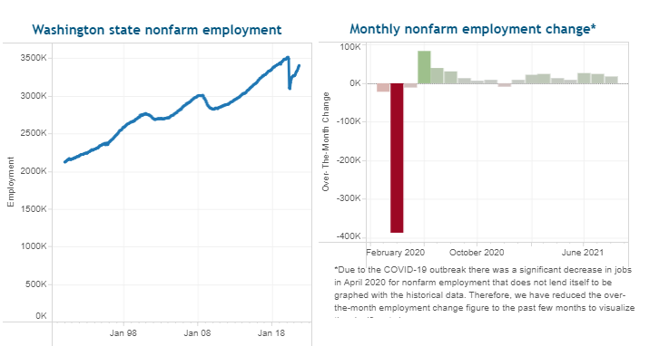
The labor market impacts were deeper and more swift than usual
Notes:
From February to April, Washington lost more than 400K jobs; a drop of about 11.5 percent.
Kitsap County had a very similar pattern

Slide 46
Whatcom County lost about 14,900 jobs.
So far 8,700 have been recovered

Slide 47
The peak unemployment rate for women was higher than that for men
Notes:
Add data points for reference
National data

Slide 48
Initial job losses by industry sector (WA):
Great Recession versus COVID-19 Recession
Industry | Percent Female
Total Nonfarm | 48.7%
Construction | 19.1%
Manufacturing | 27.9%
Wholesale | 30.6%
Retail | 48.9%
T.W.&U | 30.8%
Information | 33.2%
Financial Activities | 56.9%
Pro & Biz Serv. | 45.3%
Edu. & Health Serv. | 73.9%
Leisure & Hospitality | 53.5%
Other Services | 57.3%
Government | 44.7%
Notes:
Washington, with reference to Kitsap

Slide 49
 | White | Black or African American | American Indian or Alaska Native | Asian | Native Hawaiian or Other Pacific Islander | Two or More Race Groups | Hispanic (any race)
Construction | 87.7% | 3.1% | 1.7% | 3.4% | 0.7% | 3.3% | 14.3%
Manufacturing | 78.1% | 3.9% | 1.3% | 12.8% | 0.9% | 3.1% | 12.3%
Wholesale | 82.9% | 3.5% | 1.0% | 8.2% | 0.9% | 3.3% | 10.2%
Retail | 77.9% | 4.5% | 1.4% | 10.9% | 0.8% | 4.5% | 11.7%
T.W.&U | 78.1% | 7.5% | 1.2% | 7.5% | 1.7% | 3.9% | 9.7%
Information | 67.4% | 3.5% | 0.6% | 25.1% | 0.3% | 3.2% | 6.2%
Financial Activities | 82.0% | 4.3% | 1.0% | 8.3% | 0.6% | 3.7% | 9.3%
Pro & Biz Serv. | 76.7% | 5.6% | 1.1% | 12.1% | 0.7% | 3.8% | 9.4%
Edu. & Health Serv. | 79.6% | 5.9% | 1.1% | 9.3% | 0.6% | 3.5% | 9.4%
Leisure & Hospitality | 74.8% | 5.3% | 2.2% | 11.4% | 0.8% | 5.4% | 15.1%
Other Services | 77.2% | 5.1% | 1.2% | 11.7% | 0.6% | 4.2% | 10.1%
Government | 81.5% | 4.2% | 5.1% | 4.8% | 0.5% | 3.8% | 7.3%

Slide 50
Different industries have been impacted differently (and so have their workers)

Slide 51
UI claims gives us an idea about who has economically impacted

Slide 52
Women are more likely to be in the labor force relative to their historic labor force participation

Slide 53
Caucasian and Asian workers rejoined the workforce more quickly than BIPOC (WA)

Slide 54
A similar pattern is found in Whatcom County.

Slide 55
Snapshot of top occupations collecting UI in Whatcom County by type
(week 35 – ending September 4)
Regular UI (1,323)
  Construction occupations (270)
  Management occupations (157)
  Production occupations (134)
  Office & administrative support (121)
  Food preparation & serving (89)
PUA (1,800)
  Personal care & service (561)
  Building & grounds cleaning & maintenance (184)
  Management (181)
  Sales & related (168)
  Arts, design, entertainment, sports & media (168)
PEUC (2,492)
  Management (342)
  Production (313)
  Office & administrative support (284)
  Construction (259)
  Food preparation & serving (252)

Slide 56
Impacts to the labor force:
Who has left and who is coming back?
Notes:
But job losses are only part of the story…

Slide 57
Women left the labor force in greater numbers than men overall (US)
Notes:
Describe LFPR graph and numbers while on this slide.

Slide 58
White men fared better than Black or Latinx men in the labor market

Slide 59
The intersection between race / ethnicity and gender matters (US)

Slide 60
Working from home or not working as a result of COVID-19

Slide 61
Women were more likely than men to work from home as a result of the COVID-19 pandemic

Slide 62
White and Asian workers were the most likely to work from home; Hispanic and Black workers were more likely to be laid off

Slide 63
Management and office workers could work from home; service and goods production suffered greater job losses

Slide 64
Full time vs part time makes a difference

Slide 65
Education level represents barriers or opportunities, depending on who you are.

Slide 66
Why has supply not caught up with demand?
(a.k.a. Is there a labor shortage?
How do women and BIPOC figure in?)

Slide 67
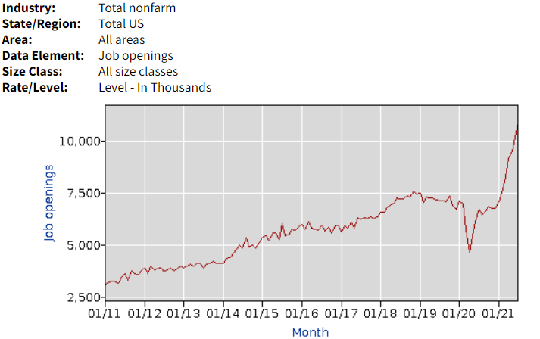
Demand:
Unprecedented job postings signal that businesses are digging out of a hole

Slide 68
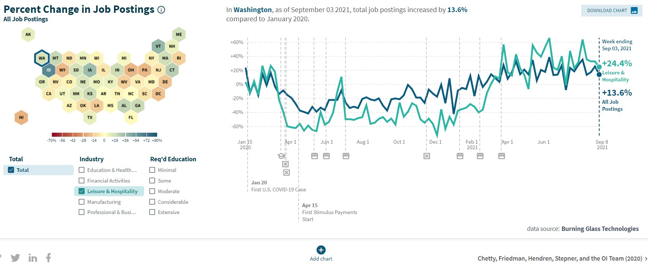
Demand:
Online job postings tell a similar story locally.

Slide 69
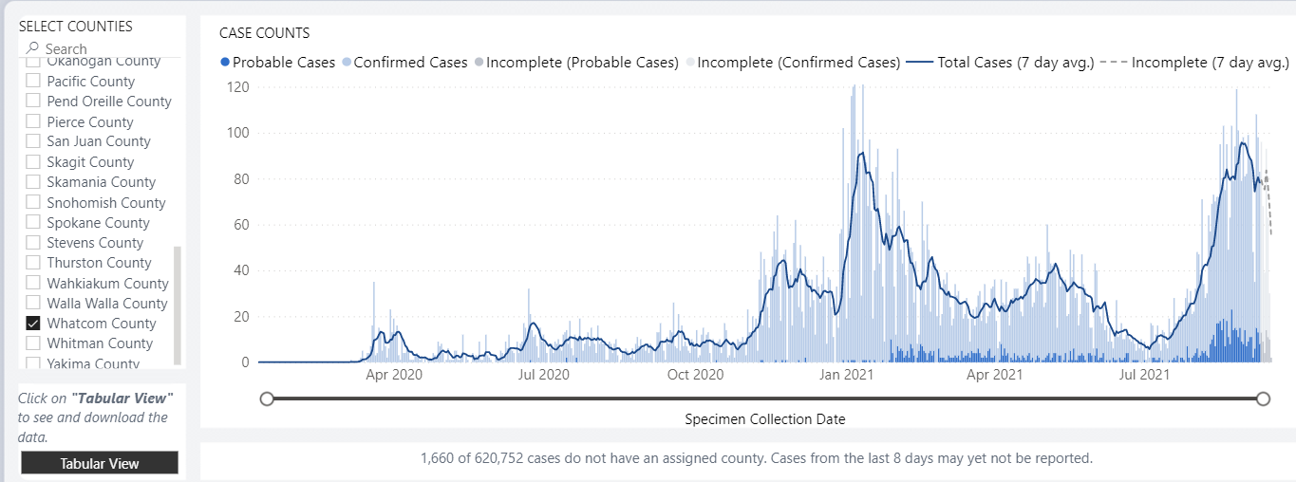
Supply and Demand:
The reality is, we are still in a pandemic

Slide 70
Supply:
Unemployment Insurance claims
The CARES Act expanded unemployment insurance eligibility and benefits
  Pandemic Unemployment Assurance (PUA)
  Pandemic Emergency Unemployment compensation (PEUC)
  Pandemic Emergency Benefits (PEB)
Did generous benefits keep workers out of the labor market?
  $600 additional federal benefit (exp. August 2020)
  $300 additional federal benefit (exp. September 4, 2021)

Slide 71
Supply:
The care economy disproportionately impacts women
Care for elders
  Increased risk related to COVID-19 exposure
Care for children
  Childcare – affordability and accessibility
  School – online learning and inconsistent schedules
Returning to high-risk jobs is largely incompatible with roles women are expected to assume in the care economy
Notes:
In short, the industry signature of this crisis intersected with long-standing cultural norms and structural challenges disadvantaged women

Slide 72
The effects of structural barriers has been amplified in the recession (in every recession, truthfully)
Part time, low wage, and low education jobs are the first to go, and take more time to return
Service sector jobs were impacted to the greatest extent
  These jobs tend to be held disproportionately by women, immigrants and people of color

Slide 73
Implications moving forward
Time out of the labor market →perceived skills atrophy and increased barriers in the labor market
Technology progressed quickly during the recession
We are still in a pandemic! Outbreaks at school could send women back home, placing women in a vulnerable position and childcare may not return as quickly as other industries
The sunsetting of CARES Act could put pressure on other support systems

Slide 74
Thank you!

Slide 75
Prosperity Project:
Community Needs Assessment

