Slide 1
On shaky ground: Stabilizing the financial security of single women
Amy Castro Baker, PhD
School of Social Policy & Practice
University of Pennsylvania
Stacia Martin-West, PhD
College of Social Work
University of Tennessee
Folasade Famakinwa, MSSP
School of Social Policy & Practice
University of Pennsylvania Law School
In Partnership with:
Closing the Women’s Wealth Gap
Asset Funders Network
Funded By:
the Dallas Women’s Foundation, The Chicago Foundation for Women, & AARP

Slide 2
“Good innovators typically think very big and they think very small. New ideas are sometimes found in the most granular details of a problem where few others bother to look. And they are sometimes found when you are doing your most abstract and philosophical thinking, considering why the world is the way that it is and whether there might be an alternative to the dominant paradigm. Rarely can they be found in the temperate latitudes between the two spaces, where we spend 99% of our lives.”
~Nate Silver, The Signal and the Noise

Slide 3
Women & Wealth
Why wealth?
Single women of all ages own $.32 for each dollar of wealth owned by single men.
Single Black and Hispanic women own less than $.01 for each dollar of wealth owned by their White male counterparts.

Slide 4
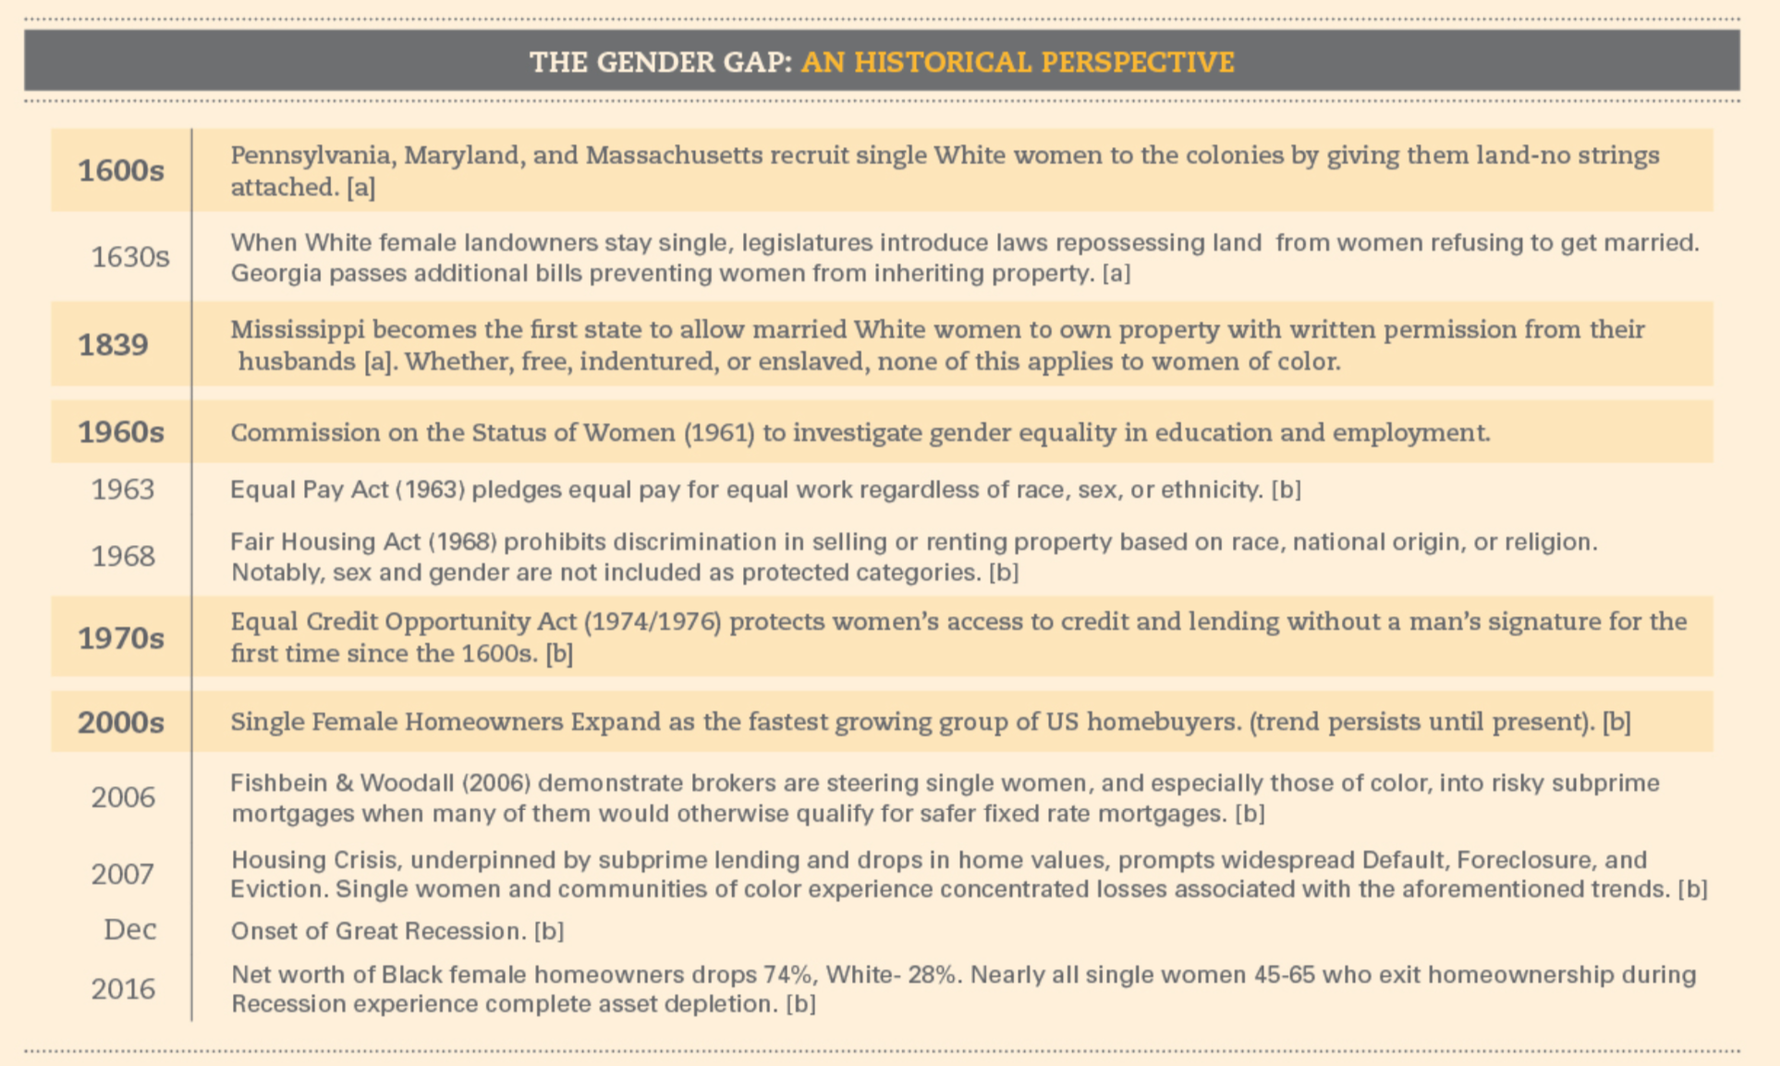

Slide 5
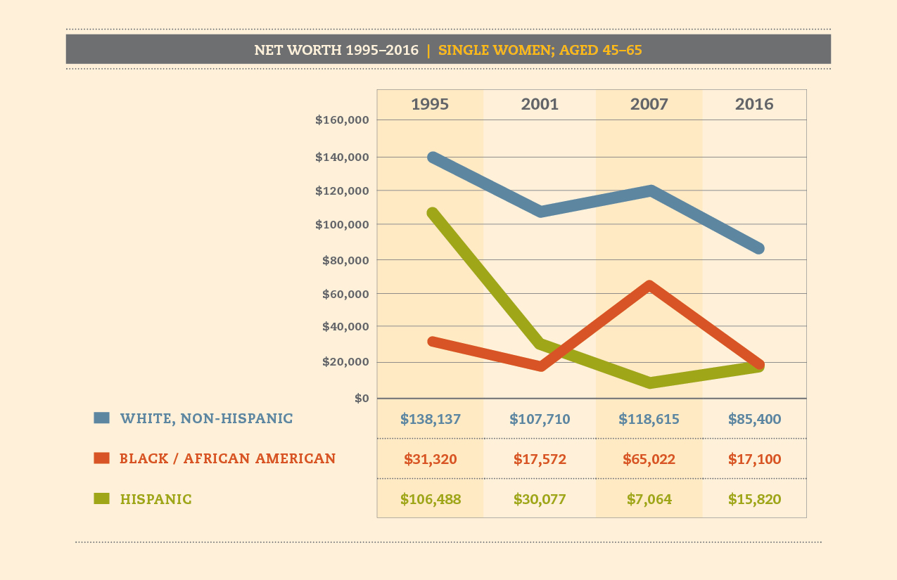

Slide 6
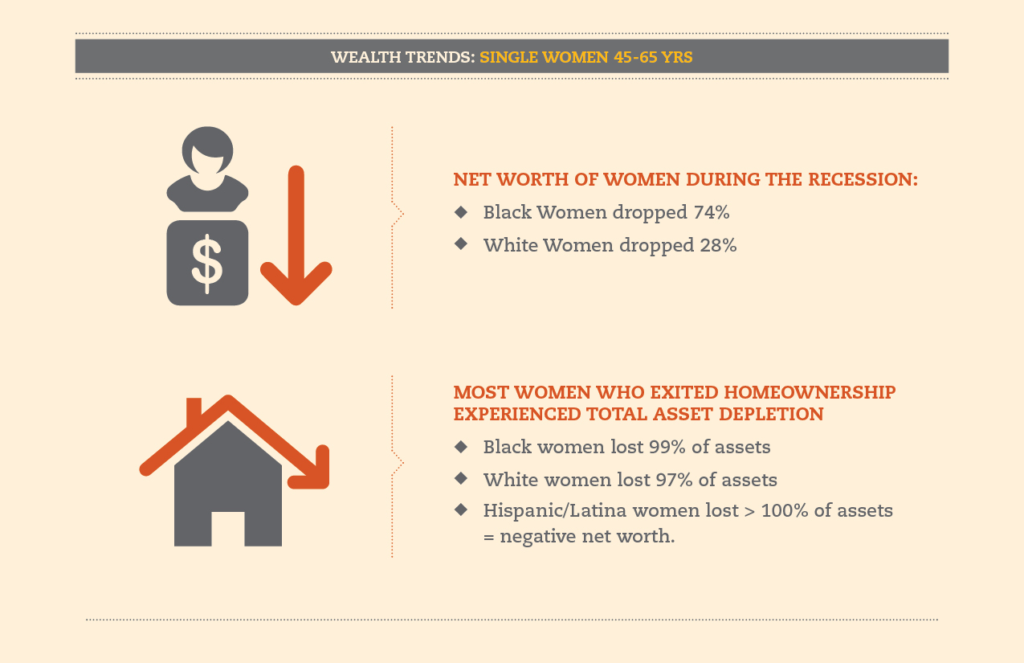

Slide 7
Key Problem Drivers
Legacy of racial and sexual discrimination in credit and lending.
Gender inequities in homeownership
Ineligibility for retirement plans
Lack of access to coaching
Algorithmic Bias

Slide 8
Strategies for Action
Lifespan Approach to Coaching, Building, and Protecting Wealth
Easing the Cost of Housing
Elevate Invisible Populations of Women
Leverage Technology and Predictive Analytics
Legal Aid

