Slide 1


Advancing gender wealth equity:
Opportunities in the 2019 legislative session
Liz Olson, state policy fellow
March 21, 2019

Slide 2
WORKING FAMILIES TAX CREDIT

Slide 3
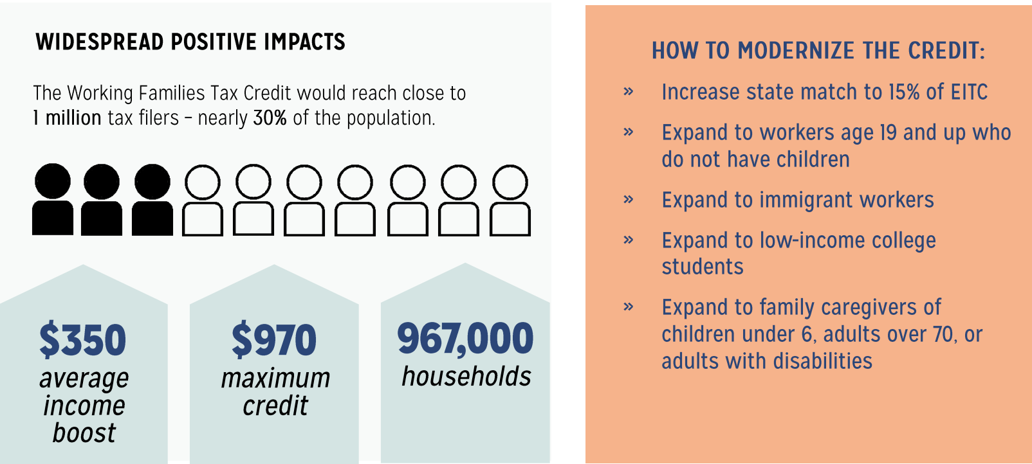
Working Families Tax Credit
Washington state’s version of the federal Earned Income Tax Credit (EITC)
WFTC would provide a 15% match to the federal EITC
It would reach close to 1 million tax filers – nearly 30% of the population.

Slide 4
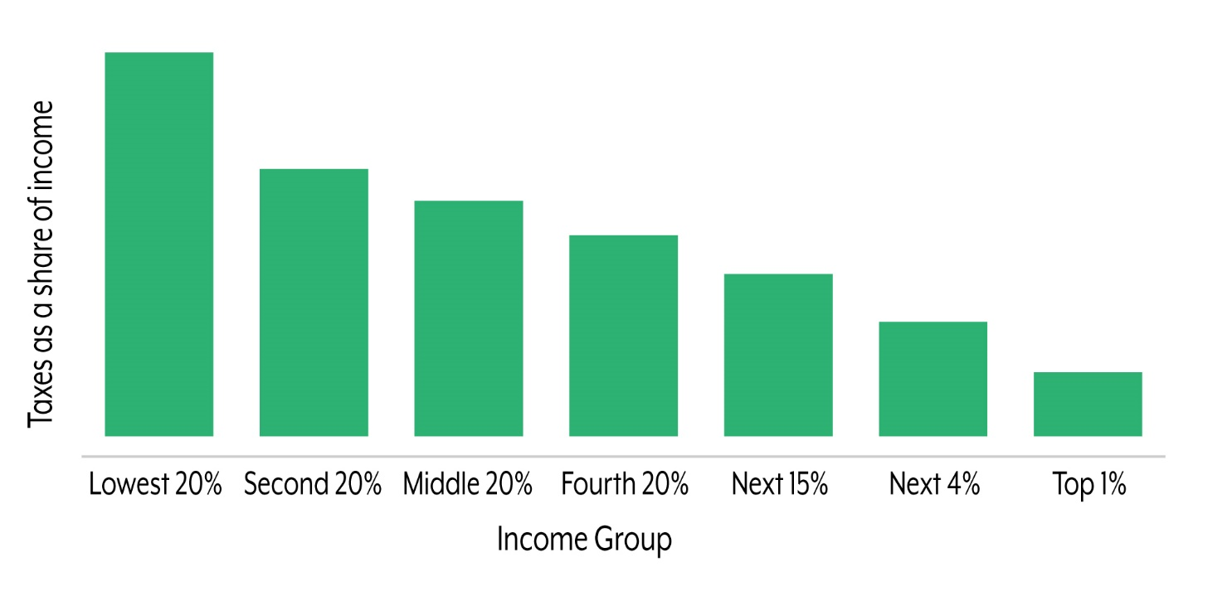
Washington’s tax code is upside-down
18%
3%
Source: Institute on Taxation & Economic Policy

Slide 5
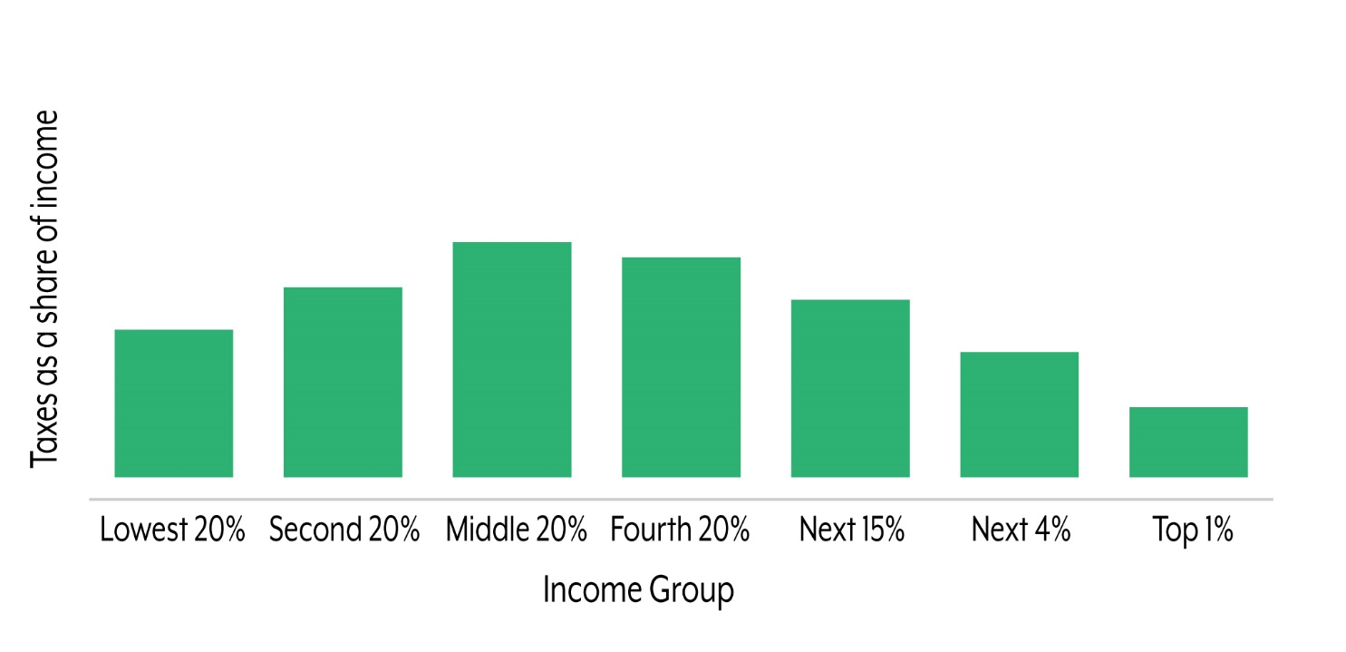
The Working Families Tax Credit can fix it
Source: Institute on Taxation & Economic Policy

Slide 6
WFTC would promote racial & gender equity by including many people who work hard but are excluded from the federal EITC.

Slide 7
WFTC is poised to have outsized positive impacts in communities of color, who, despite working hard, disproportionately struggle to make ends meet.
Percent Working Poor by Race, Ethnicity, and Nativity
Workers ages 25 to 64 working full-time living below 200 percent of poverty, Washington state 2015
Source: Budget & Policy Center analysis of 2015 5-year ACS.

Slide 8
WFTC would support economic security and asset building – particularly for women – through:
  Increased work & higher wage growth, especially for households headed by women
  Recognizing the value of unpaid caregiving labor
  Improved maternal & infant health outcomes
  Better educational outcomes including high school graduation & completion of one year of college
  Increased real value of child’s future earnings

Slide 9
CHILD CARE ACCESS NOW

Slide 10
Child Care Access Now (CAN)
The Child Care Access Now Act would put Washington on a path to establish high-quality, affordable child care for all by 2025.
Expand eligibility for Working Connections Child Care subsidy, eliminate the benefit cliff, and cap family expenses
Determine the true cost of quality and raise reimbursement rates for providers

Slide 11
Child care is one of the most significant expenses in a family's budget, rivaling the cost of college tuition and rent.
Annual statewide median cost of center-based child care compared to annual cost of in-state college tuition and fair market rent for a two bedroom apartment.
Sources: Child Care Aware of Washington, National Low Income Housing Alliance, and University of Washington Office of Admission.

Slide 12
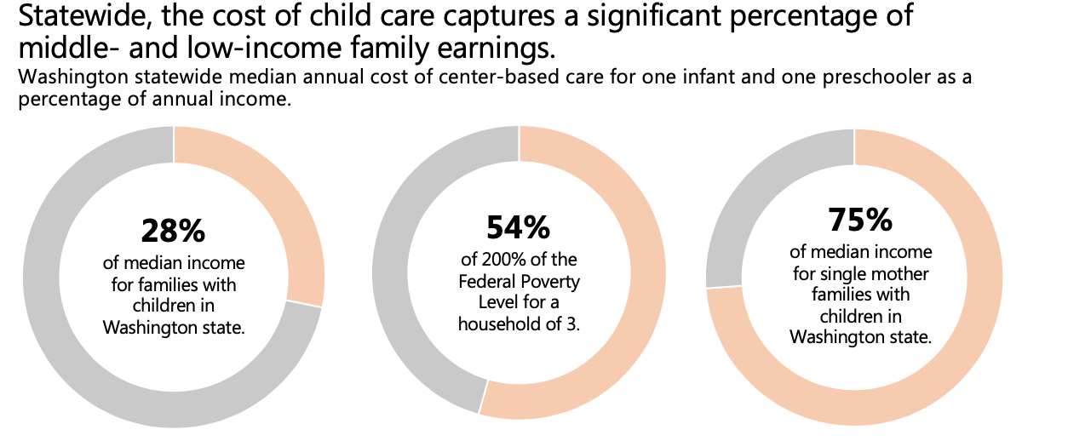
High child care costs are out of reach for low- and middle- income families, and especially for those headed by single women.
Sources: Child Care Aware of Washington, U.S. Department of Health and Human Services, Budget & Policy Center Analysis of 2017 1-year ACS

Slide 13
CAN would advance racial and gender equity by improving wages, benefits, and working conditions for the child care workforce.
  Child care workers are underpaid and undervalued, in part because of the feminized nature of their work.
    95% women
    Disproportionately Black and Latinx women
  In 2014, child care center teachers in WA earned a median salary of just $26,676 (less than $13 per hour).

Slide 14
By increasing eligibility for subsidy and capping family expenses, CAN would strengthen women’s economic security by easing pressure on family budgets and supporting parents to remain in the workforce.
  Child care assistance is associated with increased employment among single mothers and fewer work disruptions for parents with low incomes.
  When a parent leaves the workforce because they cannot afford child care, they lose up to 4x their annual salary per year – in potential wage growth and lost retirement savings over time.
Notes:
When parents leave the workforce, THEY LOSE MUCH MORE THAN JUST THEIR ANNUAL SALARY; the cost of this decision follows them for life. After taking into account the potential wage growth and lost retirement savings over time, a parent who leaves the workforce loses up to four times their annual salary per year. – Center for American progress

Slide 15
CHILD SAVINGS ACCOUNTS

Slide 16

Child Savings Accounts (CSAs)
CSAs are long-term savings or investment accounts that help children and their families, especially those from low-income families, build savings for the future.
  Incentive structures to grow savings, such as initial seed deposits or savings matches
  Savings designated for postsecondary education (e.g. college, vocational/technical schools) or for purchasing another type of asset (e.g., a house, small business)
  Account withdrawals are generally restricted

Slide 17
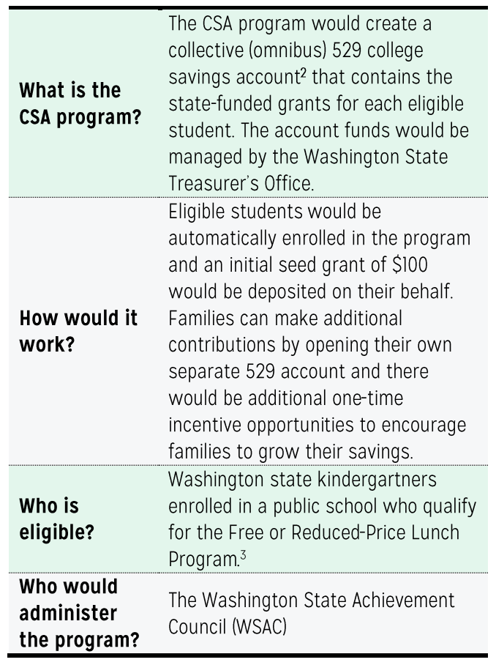
A CSA proposal for Washington state:

Slide 18
Deep economic disparities persist for children of color.
Percent of children under 18 living below the Federal Poverty Level by race/ethnicity, Washington state 2017
Source: Budget & Policy Center analysis of 2017 1-year ACS.

Slide 19
Households headed by single women are more likely to be liquid asset poor or have low or negative net worth.
Liquid asset poverty rate and zero net worth households by gender, 2017
Women overall trail behind white men’s wealth holdings, but Black and Latinx women face the greatest barriers to building wealth – holding one cent and less than one cent, respectively, for every dollar of white women’s wealth.
Source: Prosperity Now Scorecard, 2017
Notes:
Households headed by single women have a higher likelihood of being liquid asset poor and have a slightly higher likelihood of having zero or negative net worth.
Liquid Asset Poverty Rate: Percentage of households without sufficient liquid assets to subsist at the poverty level for three months in the absence of income
Households with zero net worth: Percentage of households with zero or negative net worth
Median wealth for white men: $28,900
Median wealth for white women: $15,640
Black women: $200
Latinx women: $100

Slide 20
CSAs – if designed to target kids and families furthest from opportunity – can move the needle on equity.
  Key features: categorical eligibility, automatic enrollment, incentive structure
  Broad-ranging benefits:
    College-bound identity
    Improved educational attainment
    Better maternal health & child social-emotional development

Slide 21
Liz Olson | state policy fellow
lizo@budgetandpolicy.org
Washington State Budget & Policy Center

